Slide 1
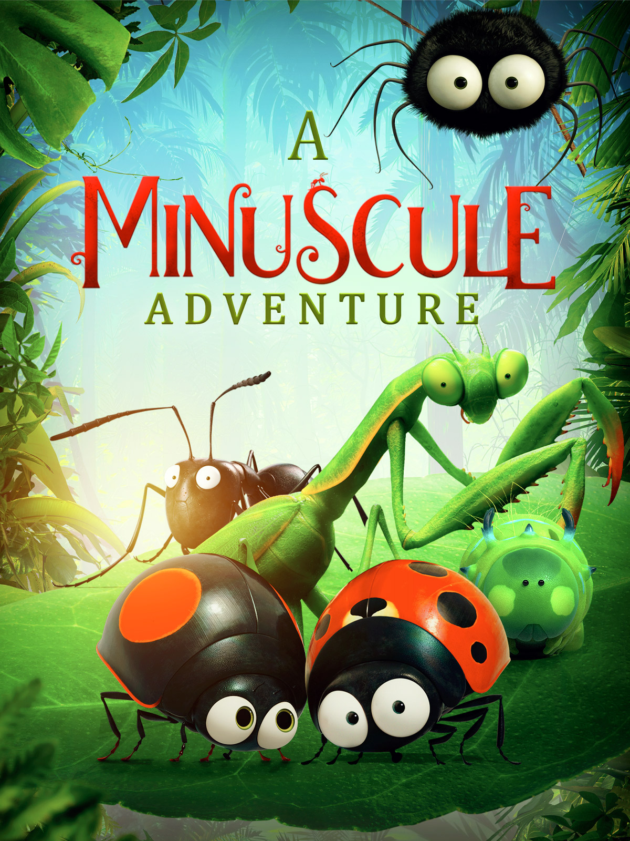
A Minuscule Adventure Minuscule - Les Mandibules du Bout du Monde
Film Resources and Worksheets
Dir. Héléne Giraud, Thomas Szabo, France, 2018
Suitable for Primary 3rd - 6th class SESE
Additional information on each slide in presentation notes.
Notes:
For Teachers
This Powerpoint presentation and accompanying worksheets have been made to support Primary SESE Education, ranging from 3rd to 6th class. They are intended to be used in conjunction with downloadable worksheets, available to download from https://ifi.ie/studyguides
Aims
To encourage students to foster an enjoyment and appreciation of film.
Encourage the pupil to engage with other living things and learn about environmental awareness and care.
Encourage questioning, investigative skills, observance of the environment, analyzing, recording and communicating.
To promote a pupil’s understanding of and personal response to the creative processes involved in filmmaking.
Outcomes
The pupil will be able to identify a variety of minibeasts in their immediate environment, as well as become aware of minibeasts from other environments.
Through observation and discussion of different habitats, the pupil will become aware of the importance of caring for said environments and develop a sense of responsibility.
The pupil will have gained an understanding of the different types of animation, and how aspects of soundtrack, colour and character design play a vital role in the filmmaking process.
The pupil will develop the ability to identify and discuss key elements in the design process, including the meaning of shape, colour and character traits.
The pupil will be able to apply this knowledge to experiment and create their own work.

Slide 2
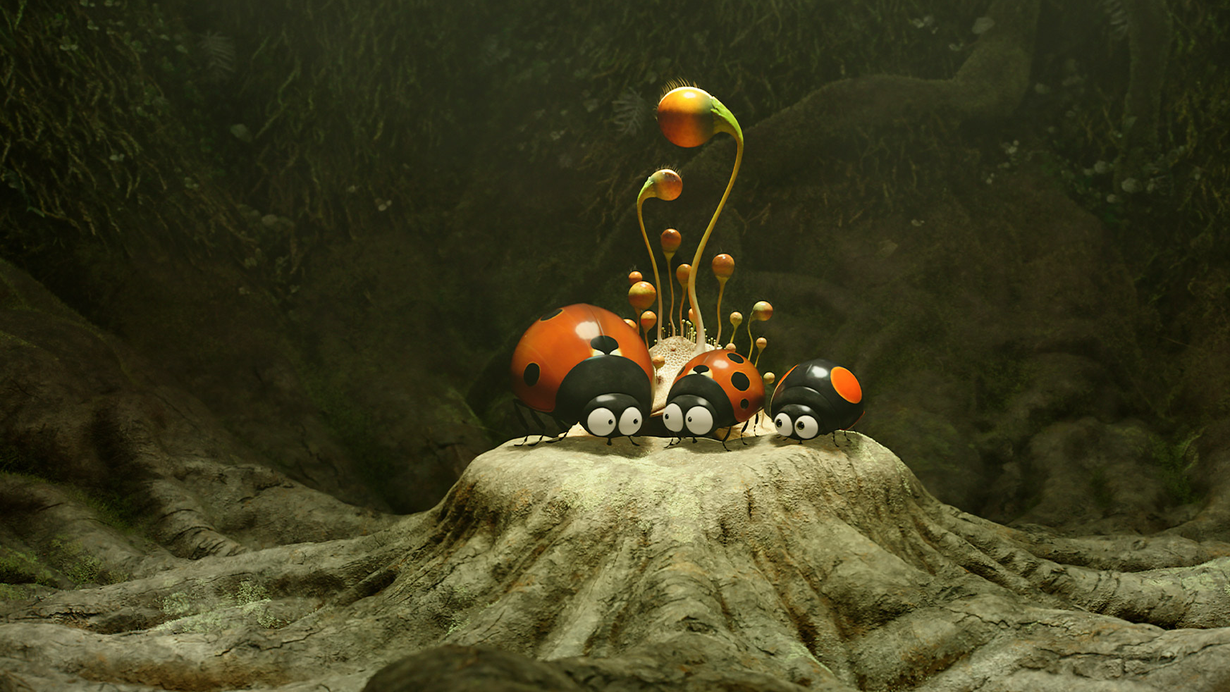
Film Synopsis
When the first snow falls in the valley, all its creatures are urgently preparing for winter. Disaster strikes when a spirited young ladybird accidentally gets trapped in a box and shipped to a Caribbean rainforest. While the young ladybird explores this new strange land, with all its wonders and dangers, it’s up to his father and friends to rescue him and return home safely.
Notes:
Teacher Notes:
This slide contains a synopsis of the film along with background information. Could be read out to the class before watching the film, or afterwards.
Background
Minuscule 2: Mandibles from Far Away is a film sequel to a popular French children’s animated series, Minuscule, and the 2013 film, Minuscule: The Valley of Lost Ants. Created by Hélène Giraud and Thomas Szabo, the series consists of short films made from a combination of computer-generated imagery and real-life locations. The aim was to provide a ‘bird’s eye view’ of the life of an insect and features a wide cast of colourful minibeasts and their comical adventures. The feature-length films continue with this concept, transporting the pint-sized characters to the big screen.

Slide 3
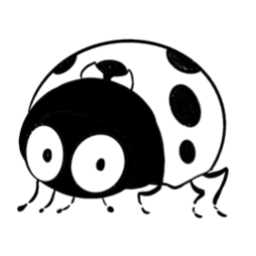
The Insect Expert Challenge
Minibeasts or Insects are small creatures. They are officially called invertebrates because they do not have a skeleton or backbone. Spiders, caterpillars, lady birds and other insects are all examples of minibeasts.
In A Minuscule Adventure, we saw at least 6 different types of minibeast.
Can you name the minibeasts you saw in the film?
Notes:
Teacher Notes:
Printable worksheets are available to download from https://ifi.ie/studyguides
This activity can be found on page 1.

Slide 4
Fill in the Blanks
How much do you know about the minibeasts in A Minuscule Adventure?
Ladybirds have ____ legs
Every colony of ants is led by a ___________
Spiders have ___ legs.
Most spiders spin _______ made from silk. This helps them to catch their food.
Caterpillars eventually grow into _______________and _________
Most Caterpillars just eat __________
Most Praying Mantids are _______, helping them blend in with leaves and trees.
Leaves Eight Butterflies Six
Webs Moths Queen Green
Notes:
Teacher Notes:
Printable worksheets are available to download from https://ifi.ie/studyguides
This activity can be found on page 1.
Answers
Ladybirds have 6 legs.
Every colony of ants is led by a queen.
Spiders have 8 legs.
Most spiders spin webs made from silk. This helps them to catch their food.
Caterpillars eventually grow into butterflies and moths.
Most caterpillars just eat leaves.
Most praying mantids are green, helping them blend in with leaves and trees

Slide 5
True or False
Continue the Insect Expert Challenge with these True or False questions! Are these facts true or false? You decide!
Only red and black ladybirds exist. True or False?
Ants are really strong. True or False?
Spiders build a new web once a week. True or False?
Caterpillars make silk. True or False?
A Praying Mantis has five eyes, but only one ear. True or False?
Notes:
Teacher Notes:
Printable worksheets are available to download from https://ifi.ie/studyguides
This activity can be found on page 2.
Answers
Only red and black ladybirds exist. FALSE
Ants are really strong. TRUE
Spiders build a new web once a week. FALSE
Caterpillars make silk. TRUE
A Praying Mantis has five eyes, but only one ear. TRUE

Slide 6
Time to Research!
Now you know all the facts, time to learn why!
Complete the Insect Expert challenge researching the questions below. Use books and the internet to help.
Why are ladybirds found in different colours?
How much can an ant carry?
How long does it take for a spider to build a web? Why do they build them?
Why do Caterpillars make silk?
A Praying Mantis can only hear high-pitched noises, why?
Notes:
Teacher Notes:
Printable worksheets are available to download from https://ifi.ie/studyguides
This activity can be found on page 2.
Students can work alone or together in groups to conduct their research.
Time permitting, challenge them to come back to the rest of the class with another fun fact about the minibeast of their choice.

Slide 7
A Habitat Investigation
In A Minuscule Adventure, the minibeasts work together to save their habitat.
What is a Habitat?
A habitat is where an animal or plant lives. It has food, water and shelter.
There are lots of different types of habitats around the world, including forests, deserts and much more!
What kind of habitat does a shark live in?
What kind of habitat does a polar bear in live in?
Notes:
Teacher Notes:
Other examples of habitats include the ocean, rainforest, mountains, grasslands, deserts, polar regions

Slide 8
Forests & Rainforests
In A Minuscule Adventure, the minibeasts visit two types of habitats
- A forest habitat and a tropical rainforest habitat.
Can you name 3 differences between forests and tropical rainforests?
For example,
Where would you find forests? Where would you find rainforests?
What is the weather like?
What kind of animals and minibeasts would you find?
Forest Habitat
Tropical Rainforest Habitat
Notes:
Teachers Notes:
Printable worksheets are available to download from https://ifi.ie/studyguides
This and additional activities can be found on page 3.
Forest Habitats
Found in cool and mild countries
Filled with both evergreen and deciduous trees
Deciduous trees have leaves that turn brown and fall off in the winter.
Some examples of animals that live in forests are
Tropical Rainforest Habitats
Found in hot, humid countries
It rains everyday
Filled with tropical, evergreen trees that don’t lose their leaves.
Some examples of animals that live in rainforests are snakes, parrots, toucans, monkeys, spiders, lizards, butterflies, jaguars, frogs, toads, sloths

Slide 9
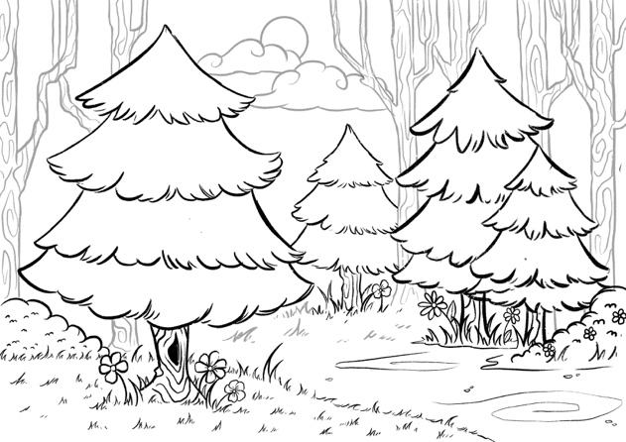
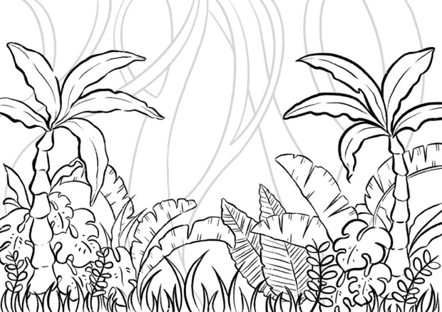
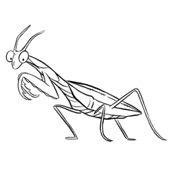
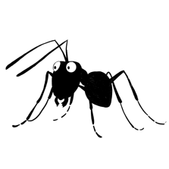
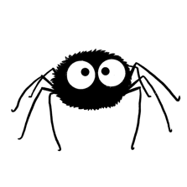
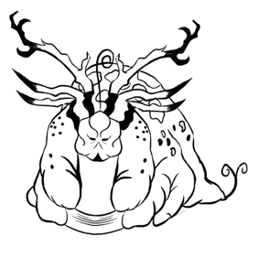
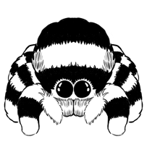
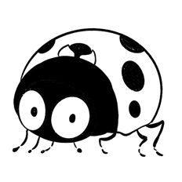
In A Minuscule Adventure, the minibeasts live in two different habitats. Match the minibeast characters to their habitats in the film!
Forest Habitat
Tropical Rainforest Habitat
Notes:
Printable worksheets are available to download from https://ifi.ie/studyguides
This and additional activities can be found on page 4.

Slide 10
Deforestation
In A Minuscule Adventure, humans want to build a hotel on the beach beside the rainforest and the minibeasts must work together to stop it. This is important because if the hotel was built, part of the rainforest would be destroyed.
This problem is called deforestation. It is when trees are chopped down to make timber and paper, or to clear space for more buildings and crops. It happens every day in rainforests all over the world.
After watching A Minuscule Adventure, why do you think deforestation is a bad for the creatures in the rainforests?

Slide 11
Time to Brainstorm!
20,000 acres of the world’s rainforests are chopped down everyday.
The rainforests are chopped down to make:
Wood, Paper, Oil and many other things.
Space for more buildings and crops
Write or Illustrate 5 things we can all do to help the rainforests.
Work as a class or in groups.
Notes:
Teacher Notes:
Printable worksheets are available to download from https://ifi.ie/studyguides
This activity can be found on page 5.
Suggestions for helping prevent deforestation could include the following;
- Use less paper
Recycling paper products so they can be used again.
Eating less meat
Tell your family and friends about the rainforests
Holding a fundraiser

Slide 12
Your Local Habitat – An Investigation! What kind of habitat is around your school or home? Investigate the area and fill in the boxes below. Answers can be written or illustrated.
What kind of plants live here?
What kind of Minibeasts live here?
What is the weather like?
What can you do to look after the creatures in this environment?
Notes:
Teacher Notes:
Printable worksheets are available to download from https://ifi.ie/studyguides
This activity can be found on page 6.

